Slide 1
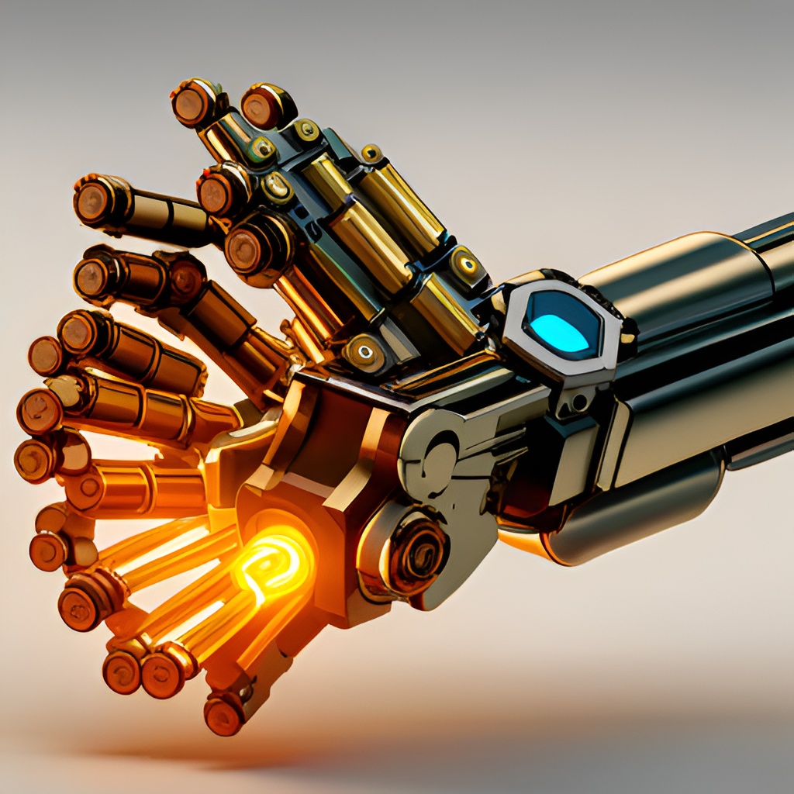
King Abdullah II School of Engineering Embedded Systems Design Project Titled: Robotic hand control system Student’s Names: Reham Awwad Alshawawreh 20218172 Hebah Mohammad Altahan 20218175

Slide 2

Overview
Introduction.
Components.
Designing a Robotic Hand Control System.
Block diagram.
Challenges.
Conclusion.

Slide 3
Introduction
Robotic hand control systems are designed to mimic the movement and dexterity of human hands. These systems use a combination of sensors, motors, and microcontrollers to achieve precise and accurate movements. The goal of these systems is to create a robotic hand that can perform complex tasks with the same level of precision and accuracy as a human hand.
The design of a robotic hand control system requires careful consideration of the various components that make up the system. Each component must be selected based on its ability to meet the specific requirements of the system. This includes factors such as size, weight, power consumption, and cost.

Slide 4
Components
Dragon 12 –JR Board /HCS12 Microcontroller
4 servo motors
Printed hand
4 flex sensors
Power supply
Resistors and wires
Glove

Slide 5
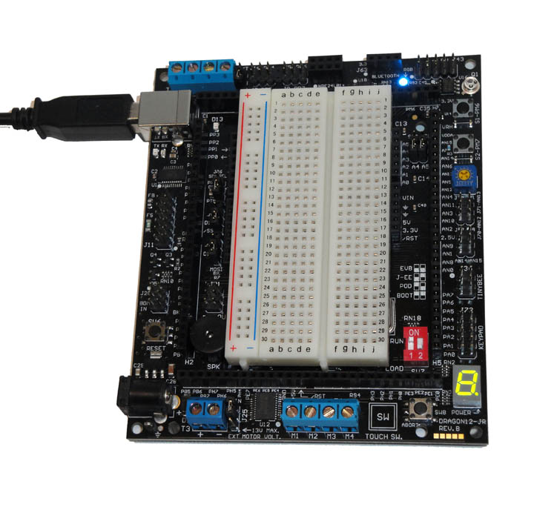
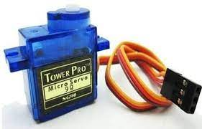
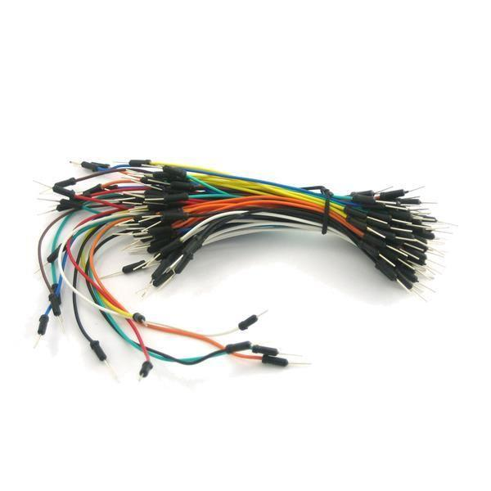
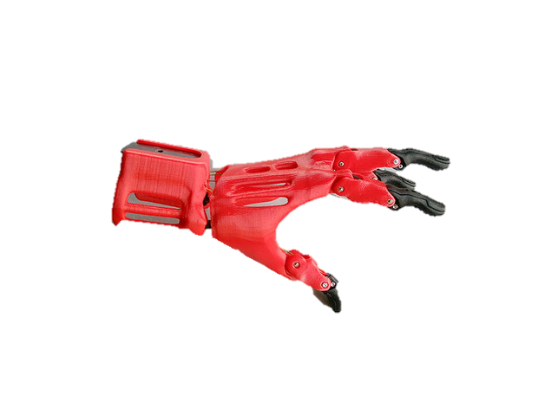
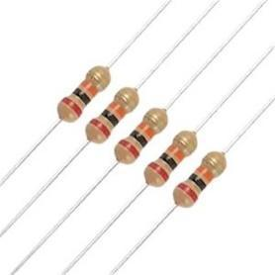
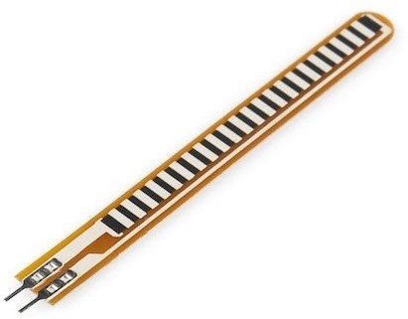

Slide 6
Designing a Robotic Hand Control System
The first step is to connect the flex sensors to the ATD0 port of the HCS12 microcontroller and calibrate them to ensure accurate readings.
Next, the PWM signal is generated using the P port of the HCS12, which is used to control the servo motors.
The servo motors are connected to the robotic hand and are programmed to move in a natural and fluid manner, mimicking the movement of a human hand.
Finally, a battery is used to power the entire system, ensuring that it can be used without being tethered to an external power source.
To ensure that the robotic hand control system functions properly, several iterations of testing and refinement must be carried out. This involves tweaking the code, adjusting the hardware, and redesigning certain components if necessary. By following this structured methodology, the challenges of developing a robotic hand control system can be overcome, resulting in a functional and accurate system that can be used in a variety of applications.

Slide 7
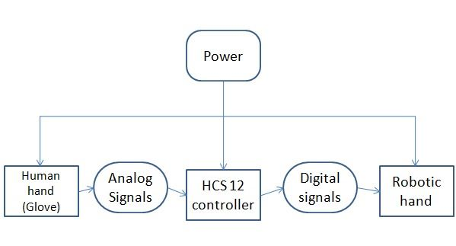
Block Diagram

Slide 8
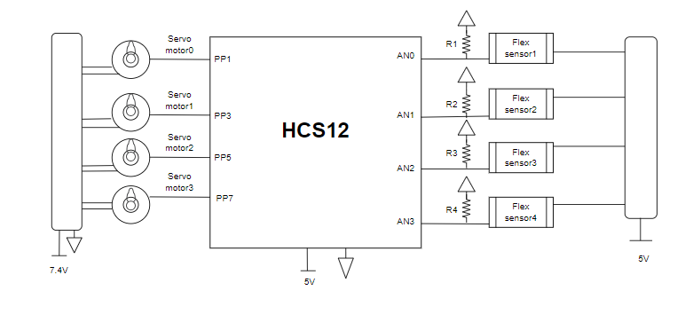
Schematic

Slide 9
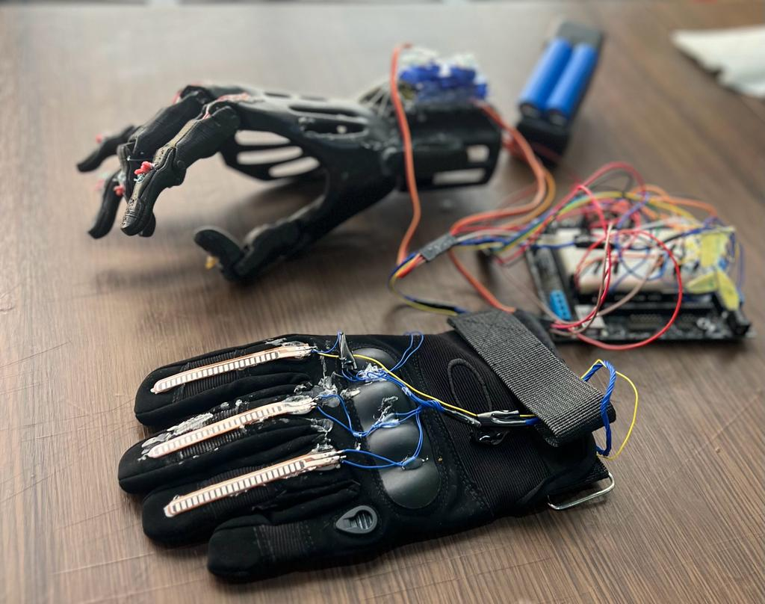
Our Project

Slide 10
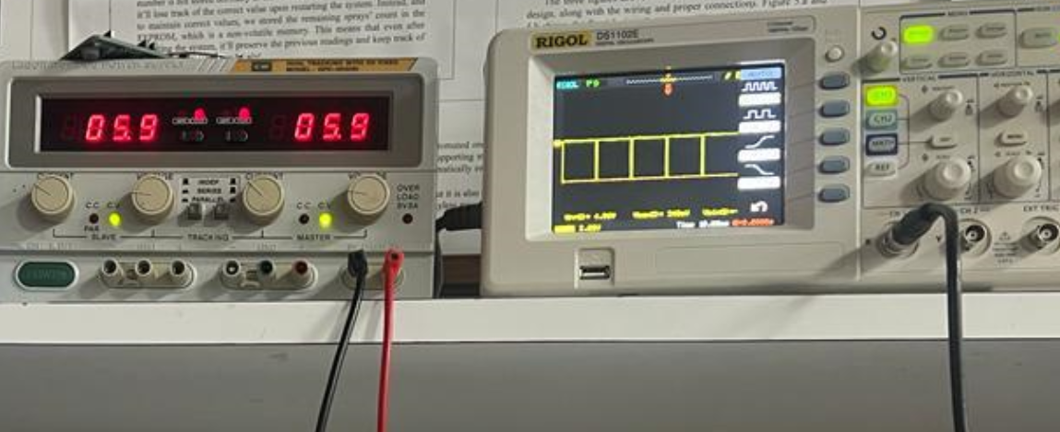
Testing
Pulses generated from movement at each Finger :

Slide 11
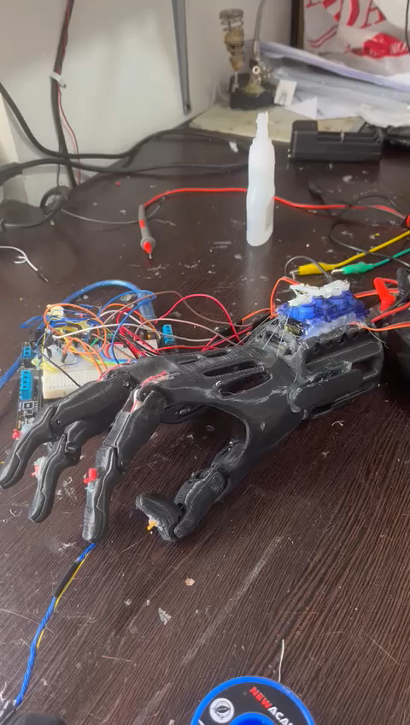
Test (Video )

Slide 12
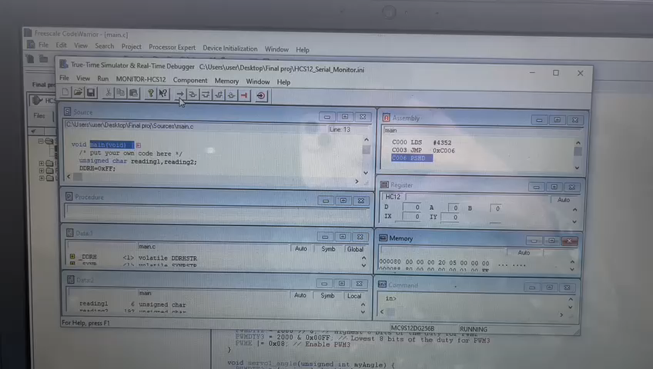
Here, our project doesn’t work completely, Why!

Slide 13
Challenges
The development of a robotic hand control system using HCS12 poses several challenges. One of the main challenges is ensuring accurate sensor readings, as any deviation can result in imprecise movements. Another challenge is programming the servo motors to move in a natural and fluid manner, mimicking the movement of a human hand. These challenges require a thorough understanding of robotics, electronics, and programming, as well as creativity and problem-solving skills.

Slide 14
Future Work
There are many possibilities for future work in this area. One such possibility is the development of a more advanced algorithm that can better mimic the natural movements of a human hand. This would require further research into the biomechanics of the human hand and the development of more sophisticated control systems.
Another area where future work could be done is in the use of artificial intelligence to control the robotic hand. By using machine learning algorithms, the robotic hand could learn from its environment and adapt to new situations. This would make it much more versatile and useful in a wide range of applications.

Slide 15
Conclusion
The use of HCS12 microcontroller, along with the flex sensors and servo motors, allows for precise control over the robotic hand's movements. This opens up possibilities for more advanced applications, such as prosthetics or even space exploration. The future of robotics is bright, and the development of systems like this one will undoubtedly play a significant role in shaping it.
the design of a control system to operate a robotic hand using an HCS12 microcontroller holds great potential for enhancing the capabilities of robotic systems. The combination of the microcontroller's processing power, integrated peripherals, and software flexibility empowers us to create a control system that facilitates precise, coordinated, and intuitive control of the robotic hand. By leveraging the control system's capabilities, we can unlock new possibilities for robotics applications, ranging from industrial automation and prosthetics to assistive technologies and exploration in challenging environments.

Slide 16
References
[1] Gautami J, Sampada A, Sahil M, Dadhich P 2017, "FLEX SENSOR BASED ROBOTIC ARM CONTROLLER: DEVELOPMENT, " International Journal of Electrical and Electronics Engineers vol. 9 pp. 494-98.
[2] Flex Sensor, [online]. Available: https://arabic.alibaba.com/ (accessed on 15 August 2020).
[3] M. A. doshi, s. j. parekh, d. bhowmick. Wireless Robotic Hand Using Flex Sensors. International Journal of Scientific & Engineering Research, 6(3), 1471-1475, March-2015.
[4] Servo Motor, [Online]. Available: https://arabic.alibaba.com/ (accessed on 15 August 2020)

